Slide 1
Rooted (Directed) Trees

Slide 2
Rooted (Directed) Trees
find the parent of C

Slide 3
Terminology for Rooted Trees
find the parent of C {b}

Slide 4
Terminology for Rooted Trees
find the parent of C {b}
find the children of g

Slide 5
Terminology for Rooted Trees
find the parent of C {b}
find the children of g {h, i, g}

Slide 6
Terminology for Rooted Trees
find the parent of C {b}
find the children of g {h, i, g}
find the sibling of h

Slide 7
Terminology for Rooted Trees
find the parent of C {b}
find the children of g {h, i, g}
find the sibling of h {i, j }

Slide 9
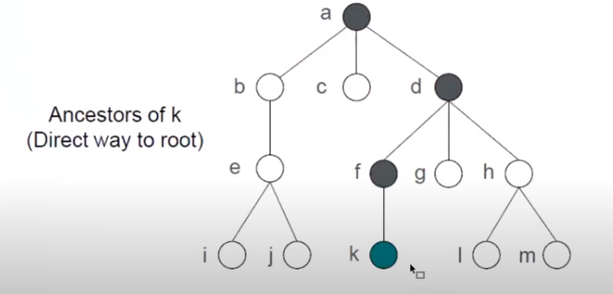
Terminology for Rooted Trees
find the parent of C {b}
find the children of g {h, i, g}
find the sibling of h {i,j }
find the ancestors of e

Slide 10
Terminology for Rooted Trees
find the parent of C {b}
find the children of g {h, i, g}
find the sibling of h { i, j }
find the ancestors of e {c, b, a}

Slide 11
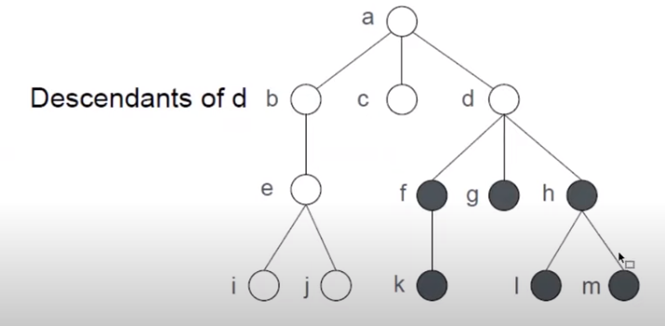
Terminology for Rooted Trees
find the parent of C {b}
find the children of g {h, i, g}
find the sibling of h { i, j }
find the ancestors of e {c, b, a}
find the descendants of b

Slide 12
Terminology for Rooted Trees
find the parent of c {b}
find the children of g {h, i, g}
find the siblings of h { i, j }
find the ancestors of e {c, b, a}
find the descendants of b {c, d, e }
find all leaves ( external nodes) {f,d,e, i,k,l,m}
find all internal nodes {a,b,g,c,h,j}

Slide 13
leaves ( external nodes)

Slide 14
internal nodes

Slide 15
Subtrees

Slide 16
Levels and Height

Slide 17
Example

Slide 18
Example

